Slide 1
Digital Creation A State of the Arts
Pierre Berger
Diccan.com Laval Virtual 2014

Slide 2
Drawing Lines on a Nebula

Slide 3
Drawing Lines on a Nebula

Slide 4
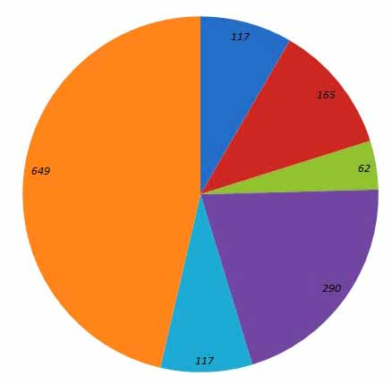
Global Patterns
All art genres/specialities are represented.
Literature 117
Music 165
Plastic arts 62
Cinema 290
Live 117
Multimedia 649
But digital technology
takes to fusion.

Slide 5
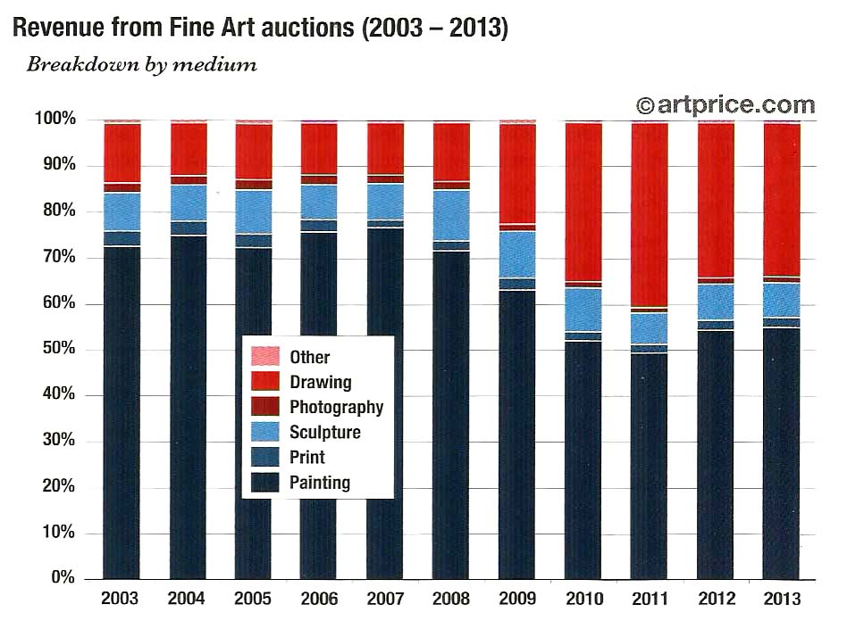
Global Patterns
All art genres/specialities are represented, a pattern quite different from « Art »

Slide 6
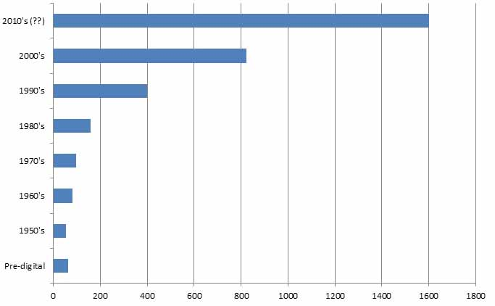
An exponential growth
Some kind of Moore’s law…

Slide 7
Digital faces limits…
… and some disappoinments !
Interaction - Generation - Artists and public attitudes
Is there progress in art ?

Slide 8
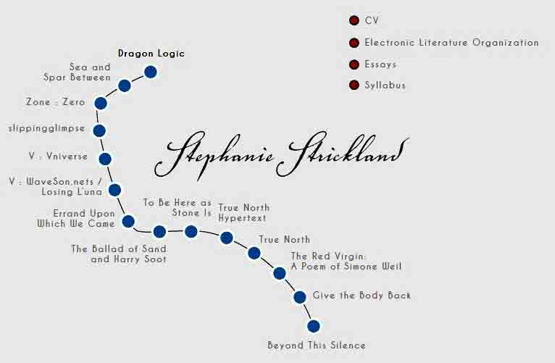
Literature: a world apart
Digital literature: a world apart
Very active (ELO)
Example: Stephanie Strickland

Slide 9
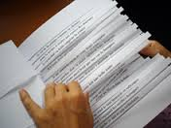
Literature: Levels
- « Combinatorial ». e.g. One hundred billion poems - Enhanced by hypertextual structures

Slide 10
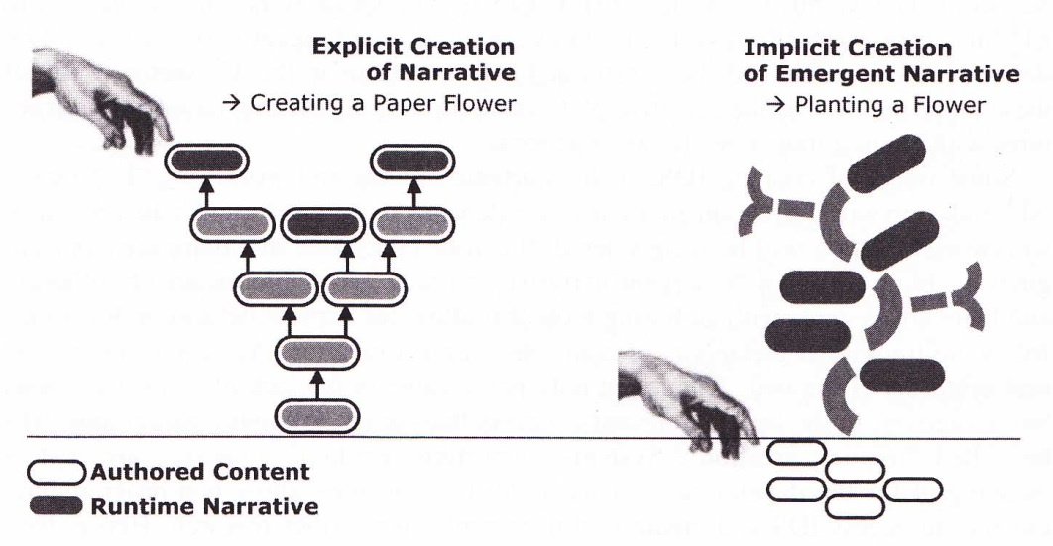
Literature: Levels
- « Combinatorial ». - « Automatic » e.g. Jean-Pierre Balpe - Storytelling

Slide 11
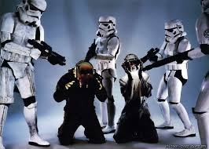
Music: in Love with Techno
Pop or savant, music has always made use of available technologies. Examples: Daft Punk.

Slide 12
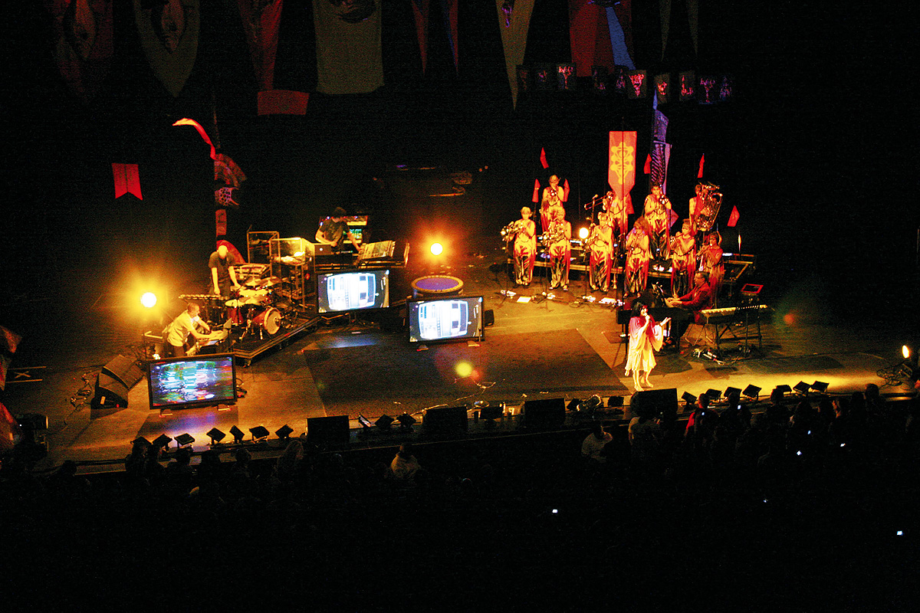
Music: in Love with Techno
Pop or savant, music has always made use of available technologies. Examples: Daft Punk, Björk

Slide 13
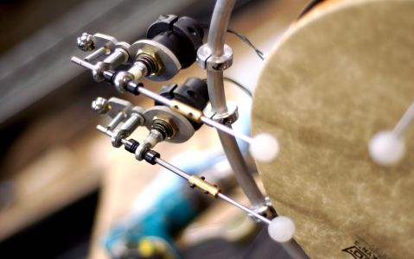
Music: advanced trends
- Robotization (generative music, accompanists).

Slide 14
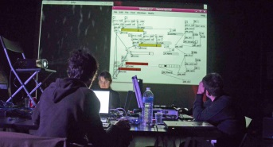
Music: advanced trends
- Robotization (generative music, accompanists). - Live coding

Slide 15
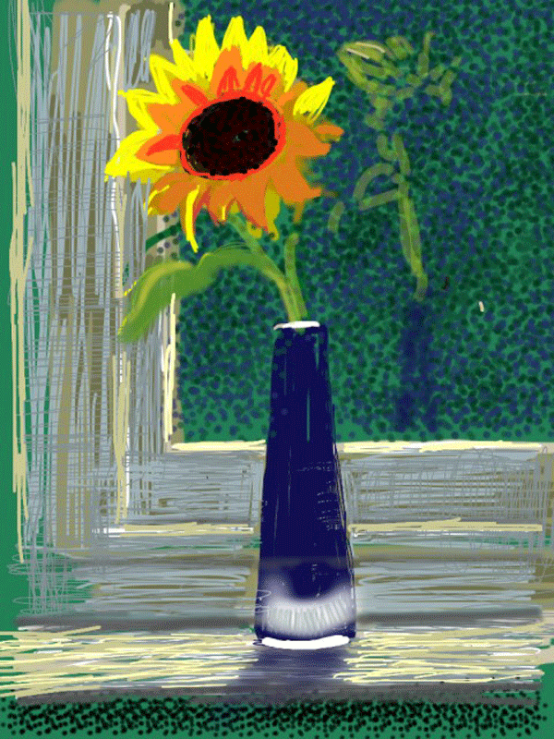
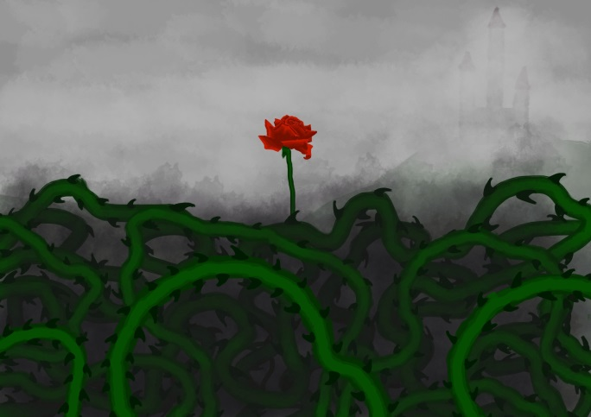
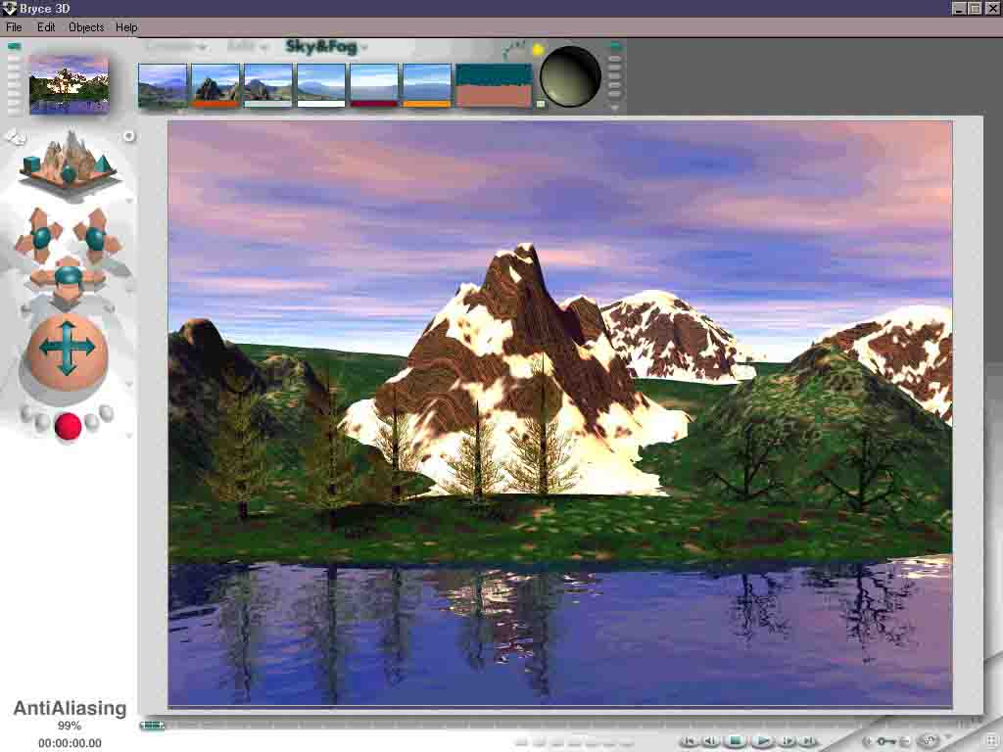
Plastic Arts: Deep Divide
Classic/Realistic Cinetic/Lights
Hockney on Ipad

Slide 16
Limits and new ways
- 3D
- Multiple views synthesis. Computational photography.

Slide 17
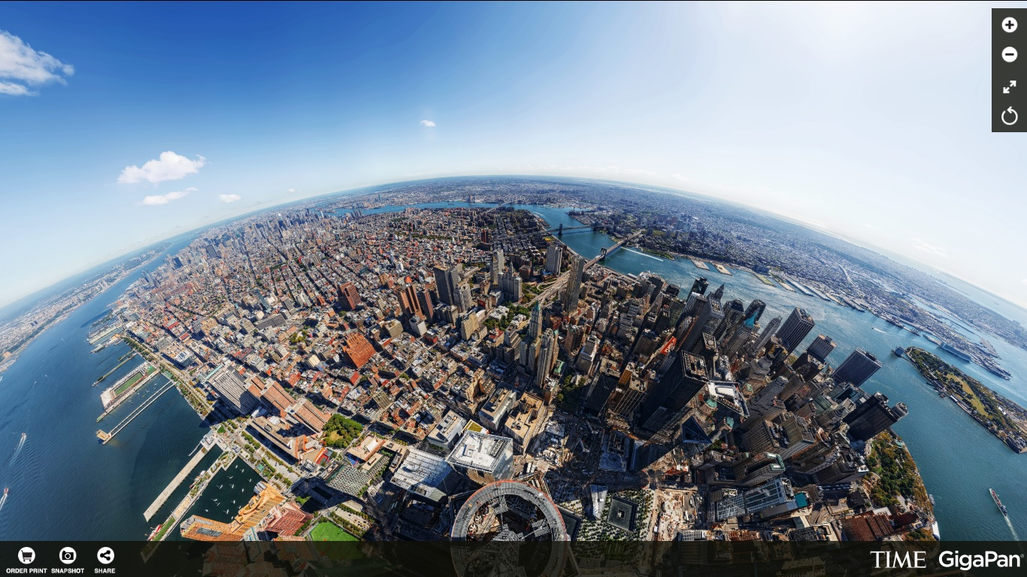
Limits and new ways
- 3D « scan »
- Multiple views synthesis

Slide 18
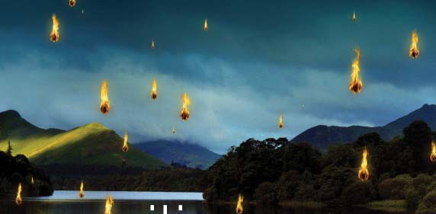
Limits and new ways
- 3D
- Multiple views synthesis - Lytro

Slide 19
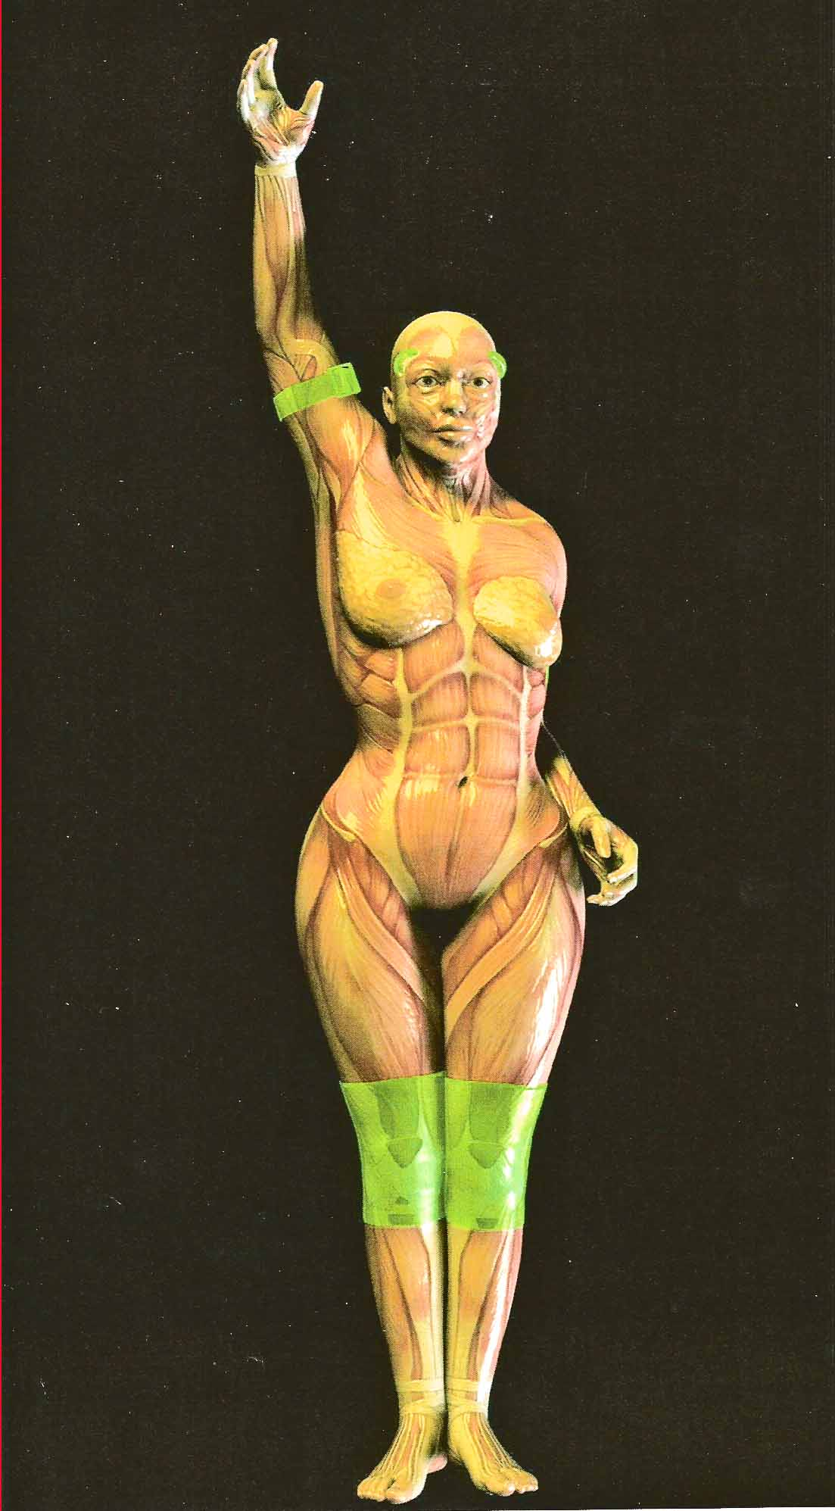
Limits and new ways
- 3D
- Multiple views synthesis - Lytro - Non photo-realistic

Slide 20
Limits and new ways
- 3D
- Multiple views synthesis - Lytro - Non photo-realistic - Generative/abstract

Slide 22
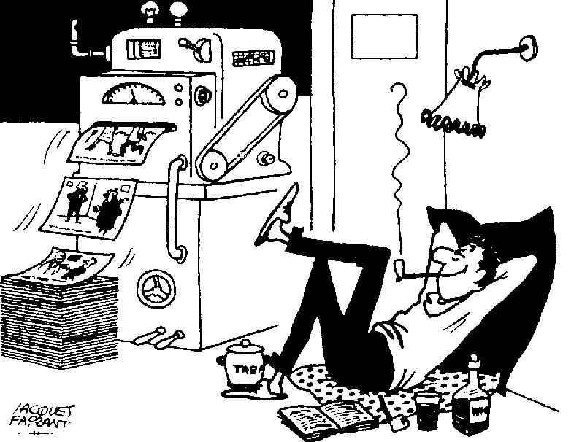
Limits and new ways
- 3D, Multiple views synthesis, Lytro, Non photo-realistic, Generative/abstract - Robotization. A dream in the 1960’

Slide 23
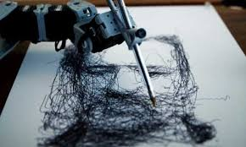
Limits and new ways
- 3D, Multiple views synthesis, Lytro, Non photo-realistic, Generative/abstract - Robotization. A dream in the 1960’ A reality today.

Slide 24
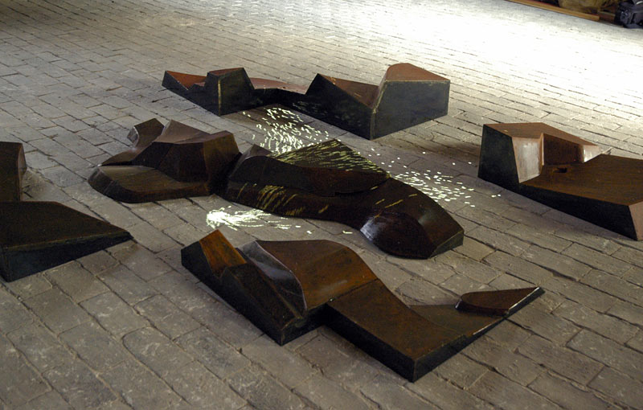
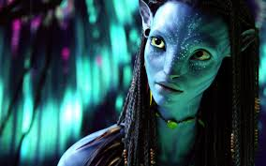
Plastic Arts: Deep Divide
Entertainment/Experimental

Slide 25
Cinema & Games: Automation
Mainstream, « Pompier » (but Enjoy…)

Slide 26
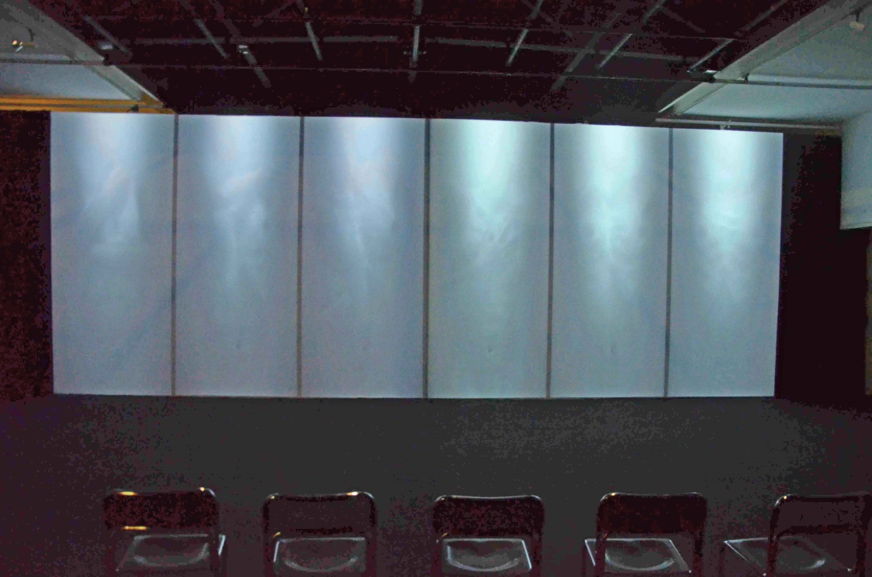
Cinema & Games: Automation
Mainstream, « Pompier » Experimental, provocative

Slide 27
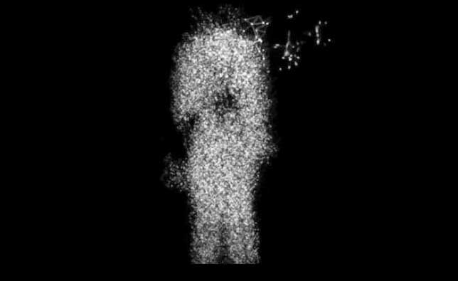
Live Performance: Body and Complexity
Clair-Obscur: Hermself

Slide 28
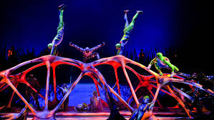
Live Performance: Body and Complexity
Cirque du soleil

Slide 29
Some general issues
Interaction
Generativity
Robotization
Multimedia/transmedia

Slide 30
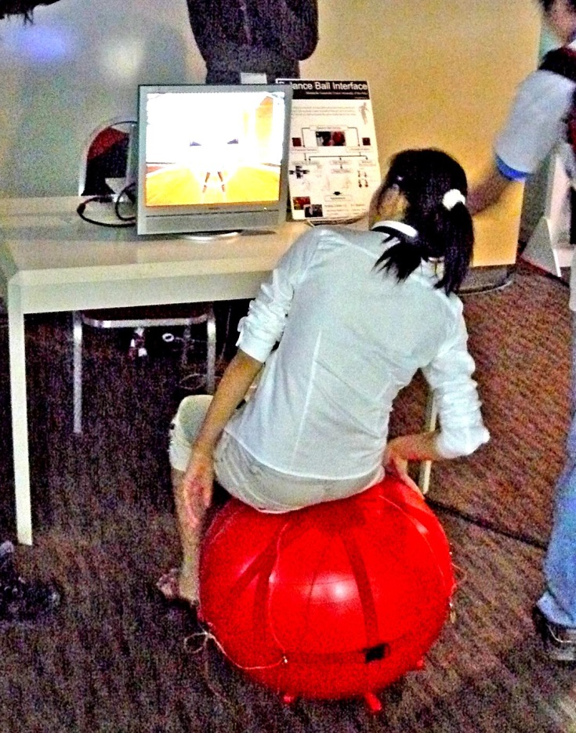
Interaction
Fun…

Slide 31
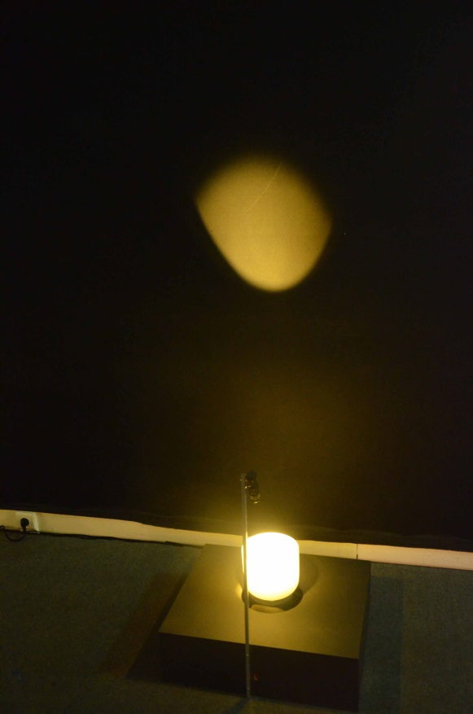
Interaction
Fun… not so easy

Slide 32
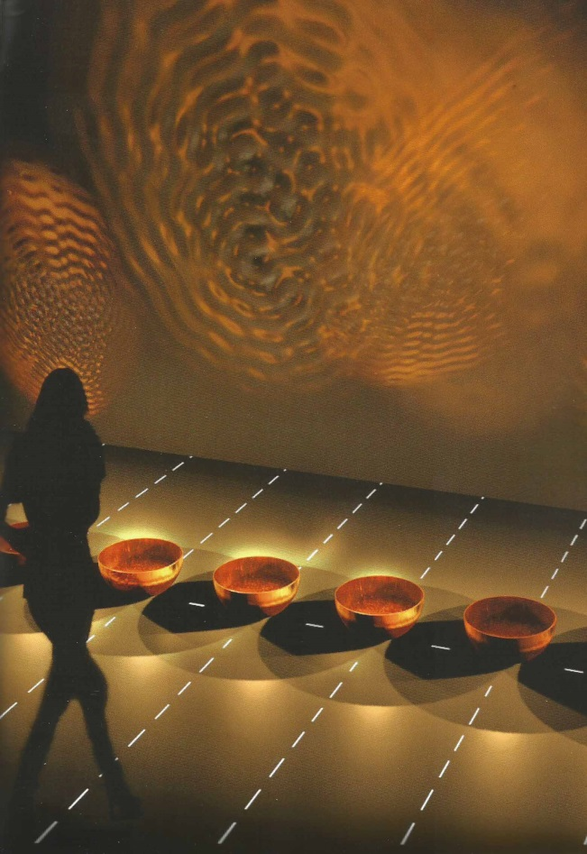
Interaction
Fun… for performers…

Slide 33
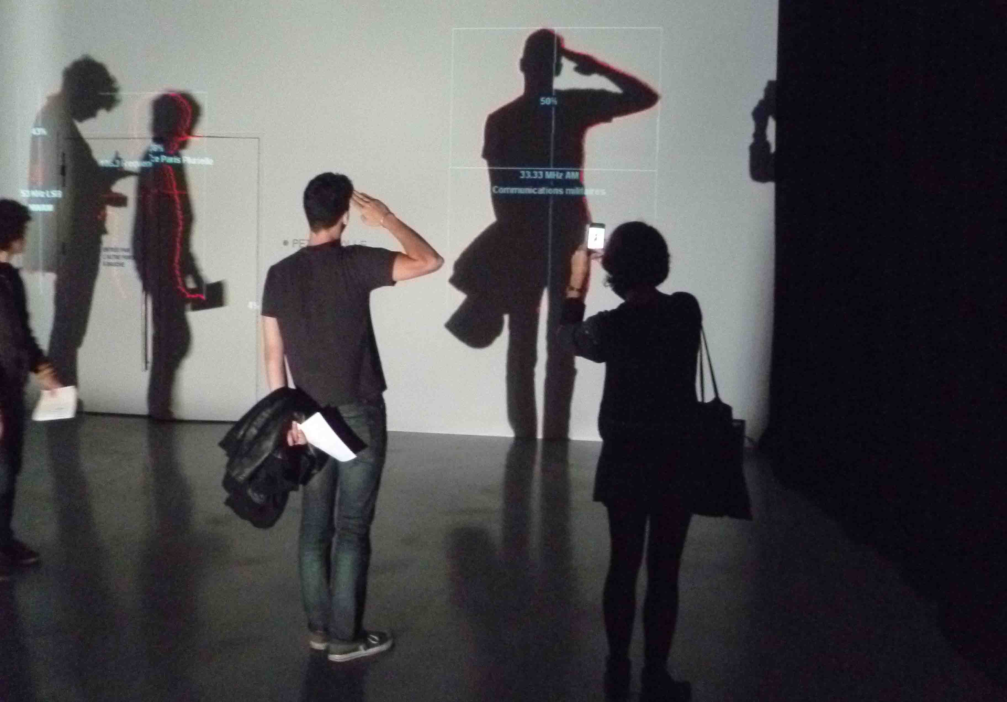
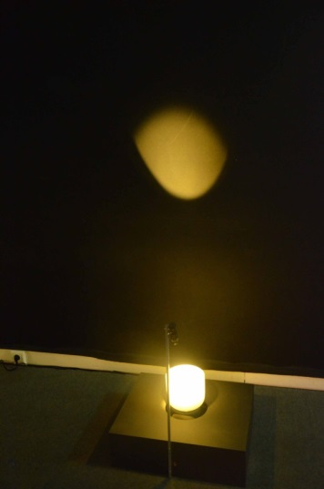
Interaction
Or not as the artist intented:

Slide 34
Interaction
Interaction suits more to games than to art
Individual artists cannot compete with the games industry.
Interaction calls for transmedia.

Slide 35
Multimedia/Transmedia
Multimedia (Transmedia widely speaking) : the convergence of many if not all "media" into a unified conceptual and industrial frame for art and design, entertainment and even the whole of social life.
Example: Moben, The mechanics of emotion.

Slide 36
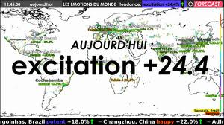
Multimedia/Transmedia
Moben, The mechanics of emotion.

Slide 37
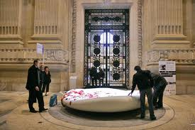
Multimedia/Transmedia
Moben, The mechanics of emotion.

Slide 38
Transmedia

Slide 39
Multimedia/Transmedia
Transmedia properly : the « second screen ». Typically: organizing different media around a TV series. Examples: Matrix, Sofia.

Slide 40
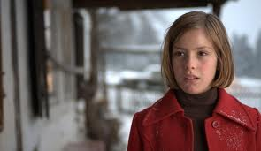
Transmedia
Kike Maillot: Eva

Slide 41
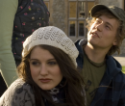
Transmedia
Kike Maillot: Eva Bernardo Sofia

Slide 42
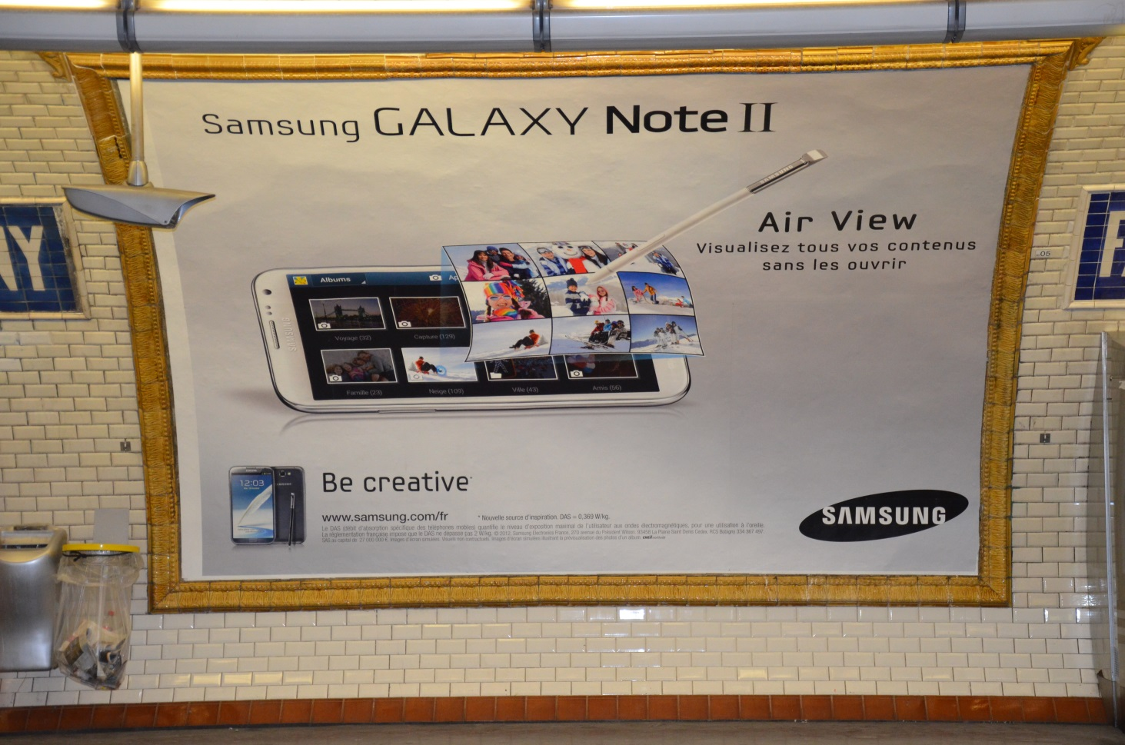
Everybody an artist ?
Samsung: be creative.

Slide 43
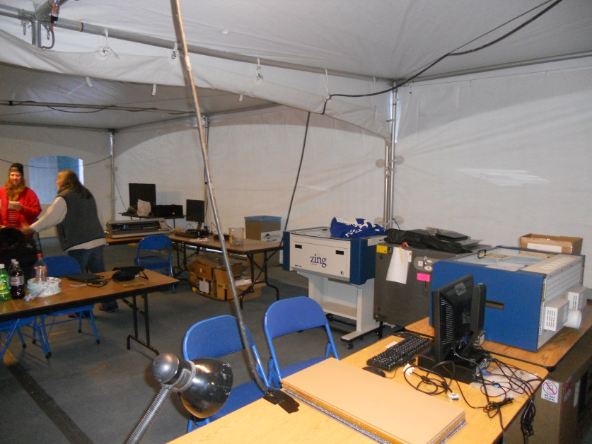
Everybody and artist ?
Fablab

Slide 44
Robots as a public

Slide 45
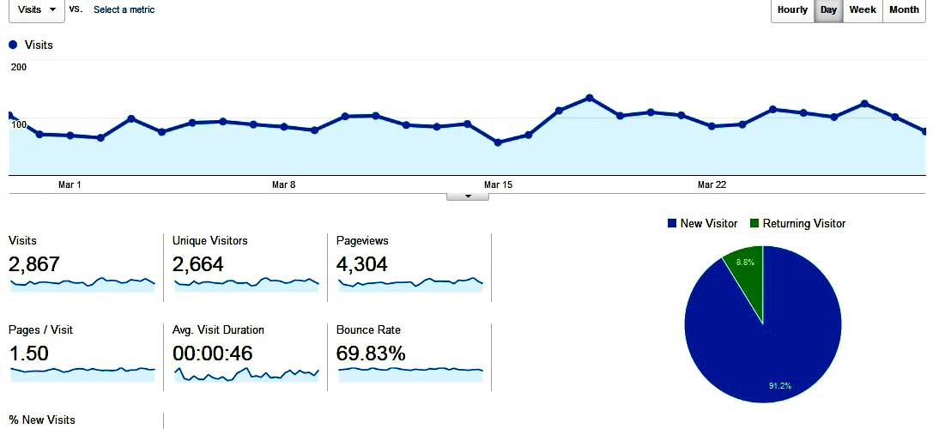
Robots as a judge
- Google ranking, analytics

Slide 46
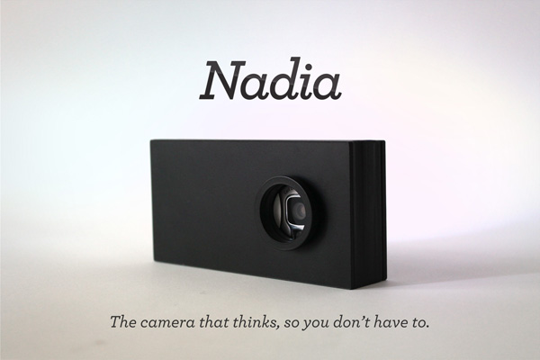
Robots as a judge
- Google ranking
- Nadia (Kupresanin)

Slide 47
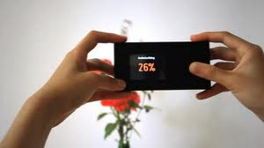
Robots as judges
- Google ranking
- Nadia (Kupresanin)

Slide 48
Clouds… and the Cloud
General convergence, interactivity, generativity

Slide 49
A future for the artists ?
The bad news is : - Cheap/easy tools for « amateurs » - Intellectual property challenged - Robotization

Slide 50
A future for the artists ?
The good news : - computing power for realism and real time - explosion of demand - easier distribution - … concentration/brands…
Great opportunities/High risks

Slide 51
Get (much) more in
http://diccan.com
And/or mail me at :
pmberger@orange.fr

